Slide 1
Image segmentation using U-Net and Mask R-CNN architectures .
AKASHCHIDAMBAR SANGAL
2GI20EC016

Slide 2
Contents :
Image segmentation
Variants of image segmentation
U-Net Architecture For Image Segmentation
MASK R-CNN .
Advantages of Mask R-CNN .
Conclusion

Slide 3
Image segmentation
Image Segmentation divides an image into segments where each pixel in the image is mapped to an object. This task has multiple variants such as instance segmentation, panoptic segmentation and semantic segmentation.

Slide 4
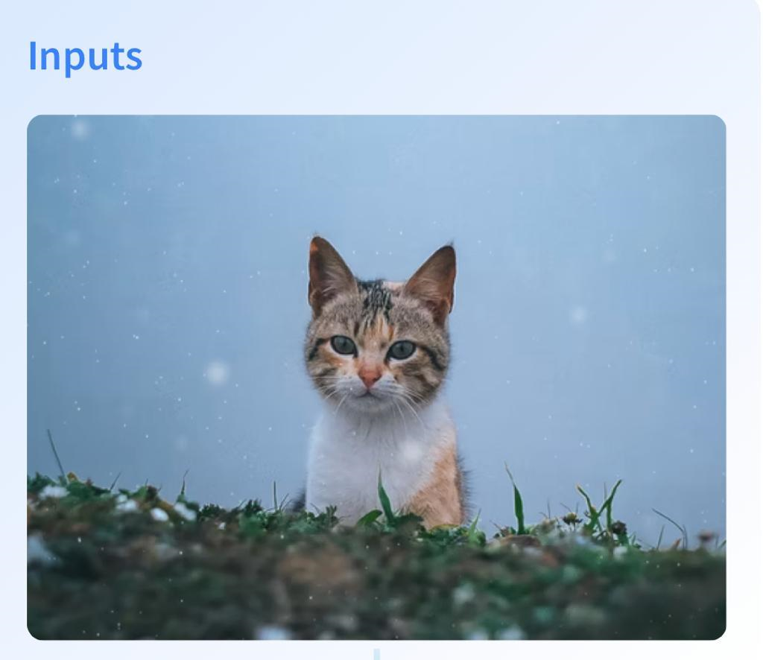
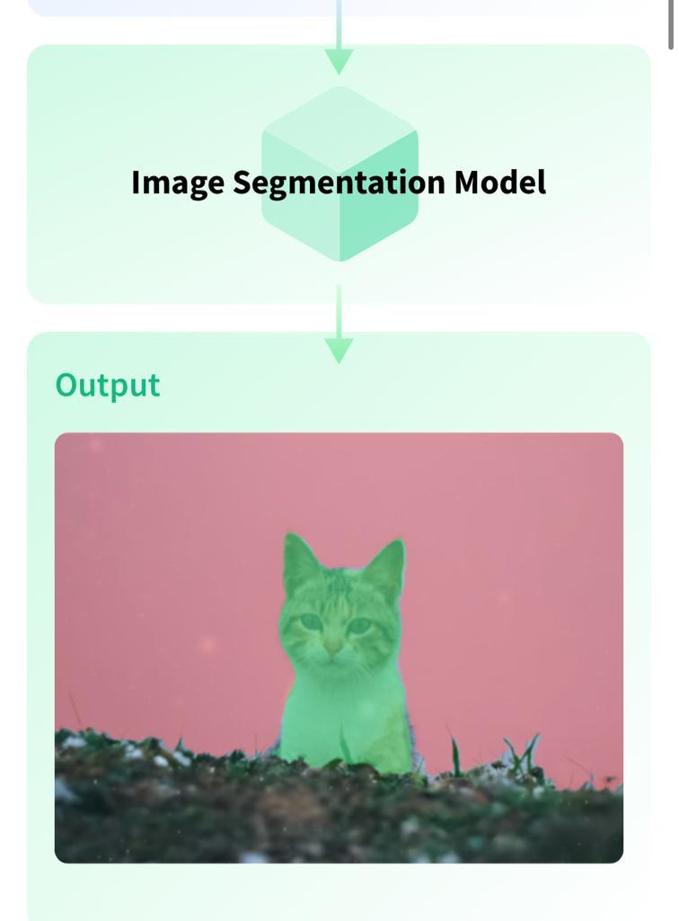

Slide 5
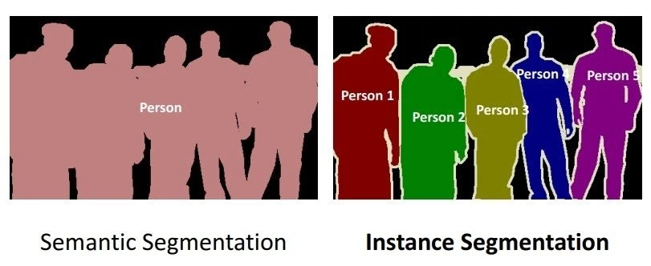
Task Variants
Semantic Segmentation
Semantic Segmentation is the task of segmenting parts of an image that belong to the same class. Semantic Segmentation models make predictions for each pixel and return the probabilities of the classes for each pixel. These models are evaluated on Mean Intersection Over Union (Mean IoU).
Instance Segmentation
Instance Segmentation is the variant of Image Segmentation where every distinct object is segmented, instead of one segment per class.

Slide 6
U-Net Architecture For Image Segmentation
The U-Net architecture, first published in the year 2015, has been a revolution in the field of deep learning. The architecture won the International Symposium on Biomedical Imaging (ISBI) cell tracking challenge of 2015 in numerous categories by a large margin.
Some of their works include the segmentation of neuronal structures in electron microscopic stacks and transmitted light microscopy images.

Slide 7
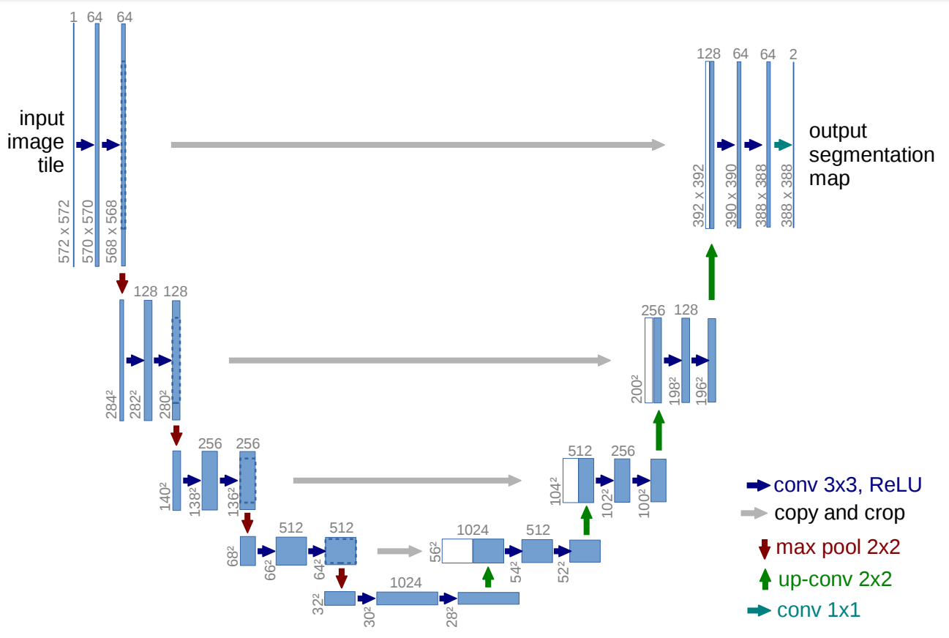
U-net block diagram :

Slide 8
MASK R-CNN
Mask R-CNN is a Convolutional Neural Network (CNN) and state-of-the-art in terms of image segmentation. This variant of a Deep Neural Network detects objects in an image and generates a high-quality segmentation mask for each instance.

Slide 9
Basic concepts
the basic concepts required to understand what Mask R-CNN is and how it works:
Convolutional Neural Networks (CNN)
Region-Based Convolutional Neural Networks (R-CNN)
Faster R-CNN with Region Proposal Networks (RPN)
Mask R-CNN and how it works.

Slide 10
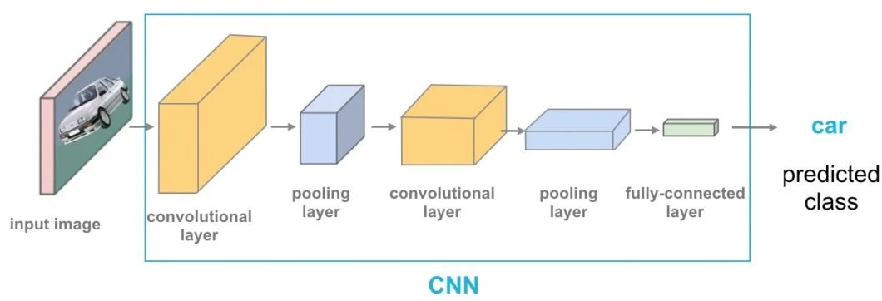
What is a Convolutional Neural Network (CNN)?
A Convolutional Neural Network (CNN) is a type of artificial neural network used in image recognition and processing that is optimized to process pixel data.
Therefore, Convolutional Neural Networks are the fundamental and basic building blocks for the computer vision task of image segmentation (CNN segmentation).

Slide 11
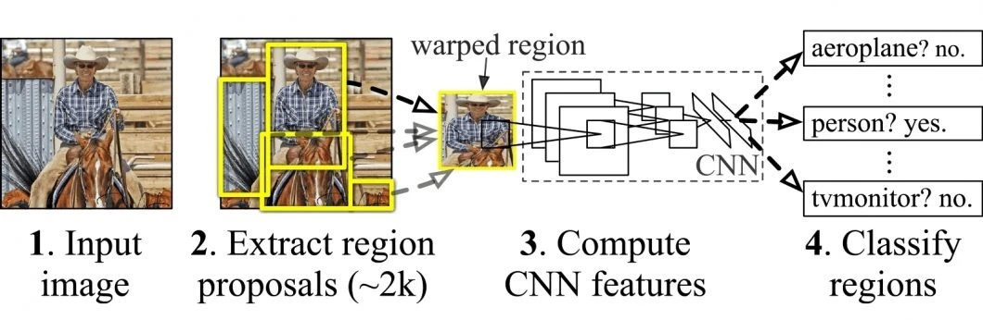
How does R-CNN work?
The following image depicts the concept of region-based CNN (R-CNN). This approach utilizes bounding boxes across the object regions, which then evaluates convolutional networks independently on all the Regions of Interest (ROI) to classify multiple image regions into the proposed class.
The RCNN architecture was designed to solve image detection tasks. Also, R-CNN architecture forms the basis of Mask R-CNN and it was improved into what we know as Faster R-CNN.

Slide 12
How does Mask R-CNN work?
Mask R-CNN was built using Faster R-CNN. While Faster R-CNN has 2 outputs for each candidate object, a class label and a bounding-box offset, Mask R-CNN is the addition of a third branch that outputs the object mask. The additional mask output is distinct from the class and box outputs, requiring the extraction of a much finer spatial layout of an object.
Mask R-CNN is an extension of Faster R-CNN and works by adding a branch for predicting an object mask (Region of Interest) in parallel with the existing branch for bounding box recognition.

Slide 13
Advantages of Mask R-CNN :-
Simplicity: Mask R-CNN is simple to train.
Performance: Mask R-CNN outperforms all existing, single-model entries on every task.
Efficiency: The method is very efficient and adds only a small overhead to Faster R-CNN.
Flexibility: Mask R-CNN is easy to generalize to other tasks. For example, it is possible to use Mask R-CNN for human pose estimation in the same framework.

Slide 14
Conclusion
Basically these two types of architecture can be used in image segmentation for better segmentation .

Slide 15
Thank you

